Slide 1
Pricing Barrier Options using Monte Carlo simulations May 1, 2018 Mohammed Ameer Khan

Slide 2
Contents
Introduction
Methodology
Results
Recommendations

Slide 3
Introduction
Barrier options are options that have a payout that is dependent not only on the terminal stock price, but also depend upon whether the stock attains some “barrier” during the life of the option. Two general kinds:
Knock-in options: The option comes into existence only if the stock reaches a given barrier during its life.
Knock-out options: The option ceases to exist if the stock reaches a given barrier during the options life.
Barrier options are cheaper than European options with same parameters because of barrier constraints.

Slide 4
Introduction(contd..)
Barrier Options
Call
Knock Out
Put
Knock In
Knock Out
Up and Out Put
Down and Out Put
Knock In
Up and In Call
Down and In Call
Up and Out Call
Down and Out Call
Up and In Put
Down and In Put

Slide 5
Introduction(contd..)
Denote c as the value of the normal European call option at time 0, c_{up-and-in} as the value of the up and in option at time 0 and c_{up-and-out} as the value of the up and out option at time 0. Then,
c = c_{up-and-in} + c_{up-and-out}
The barrier level, B has to be greater than exercise price, K for an up and out call option.

Slide 6
Introduction
Methodology
Results
Recommendations

Slide 7
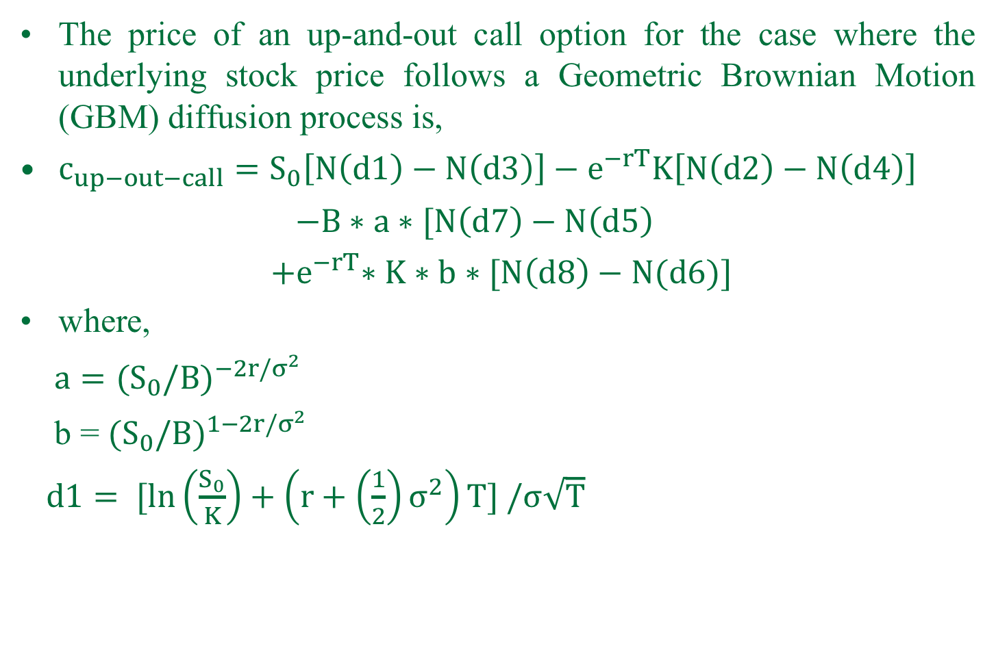
Black- Scholes model
The price of an up-and-out call option for the case where the underlying stock price follows a Geometric Brownian Motion (GBM) diffusion process is,
$c_{up−out−call}=S_{0}\left[N\left(d1\right)−N\left(d3\right)\right]−e^{−rT}K\left[N\left(d2\right)−N\left(d4\right)\right]$
$−B∗a∗[N\left(d7\right)−N\left(d5\right)$
${ +e}^{−rT}∗K∗b∗[N\left(d8\right)−N(d6)]$
where,
$a={{(S}_{0}/B)}^{−2r/σ^{2}}$
b = ${{(S}_{0}/B)}^{1−2r/σ^{2}}$
$d1= [ln\left(\frac{S_{0}}{K}\right)+\left(r+\left(\frac{1}{2}\right)σ^{2}\right)T] /σ\sqrt{T}$

Slide 8
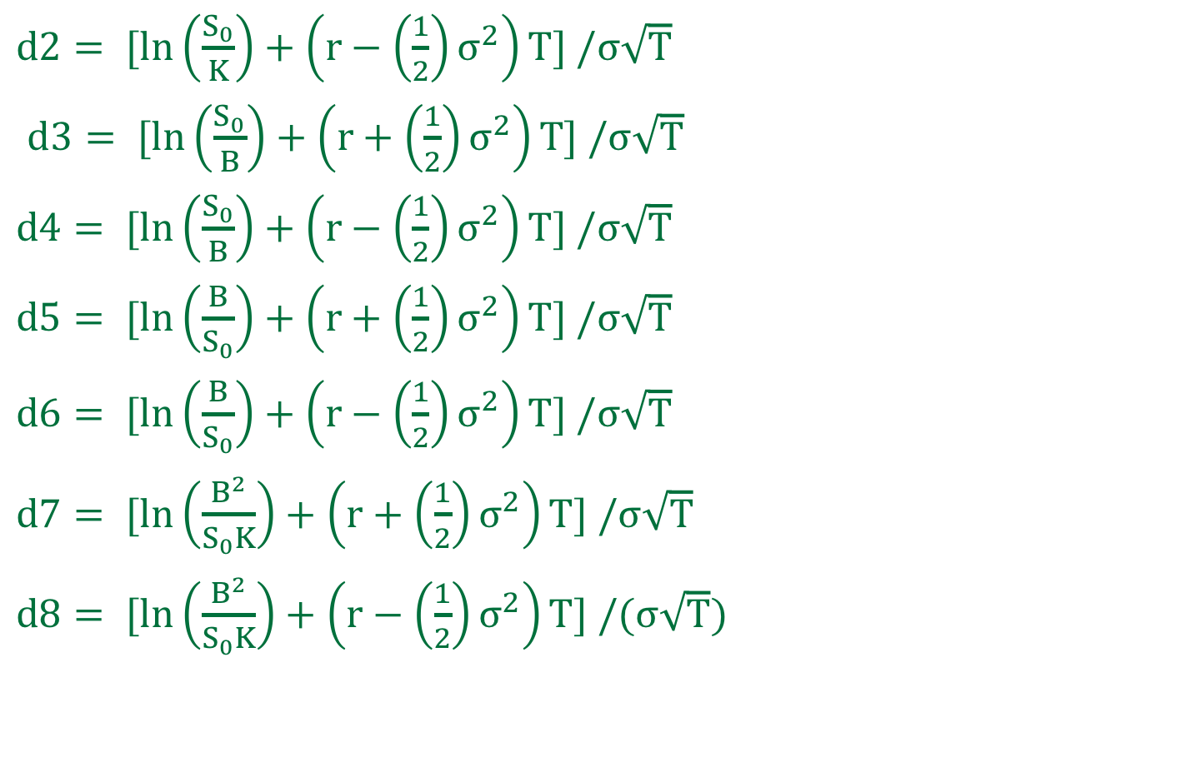
Black- Scholes model(contd..)
$d2= [ln\left(\frac{S_{0}}{K}\right)+\left(r−\left(\frac{1}{2}\right)σ^{2}\right)T] /σ\sqrt{T}$
$d3= [ln\left(\frac{S_{0}}{B}\right)+\left(r+\left(\frac{1}{2}\right)σ^{2}\right)T] /σ\sqrt{T}$
$d4= [ln\left(\frac{S_{0}}{B}\right)+\left(r−\left(\frac{1}{2}\right)σ^{2}\right)T] /σ\sqrt{T}$
$d5= [ln\left(\frac{B}{S_{0}}\right)+\left(r+\left(\frac{1}{2}\right)σ^{2}\right)T] /σ\sqrt{T}$
$d6= [ln\left(\frac{B}{S_{0}}\right)+\left(r−\left(\frac{1}{2}\right)σ^{2}\right)T] /σ\sqrt{T}$
$d7= [ln\left(\frac{B^{2}}{S_{0}K}\right)+\left(r+\left(\frac{1}{2}\right)σ^{2}\right)T] /σ\sqrt{T}$
$d8= [ln\left(\frac{B^{2}}{S_{0}K}\right)+\left(r−\left(\frac{1}{2}\right)σ^{2}\right)T] /(σ\sqrt{T})$

Slide 9
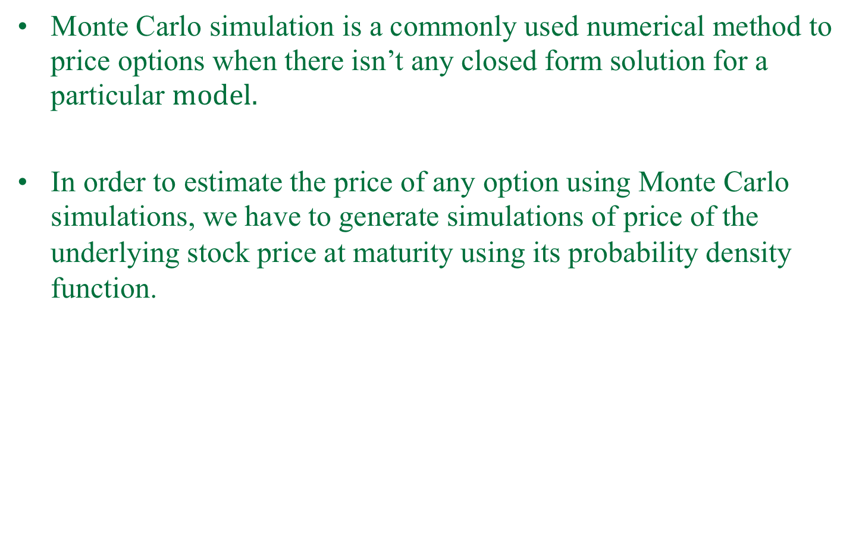
Monte Carlo simulation
$\text{Monte} \text{Carlo} \text{simulation} \text{is} \text{a} \text{commonly} \text{used} \text{numerical} \text{method} \text{to} \text{price} \text{options} \text{when} \text{there} \text{isn}\text{’}\text{t} \text{any} \text{closed} \text{form} \text{solution} \text{for} \text{a} \text{particular} model.$
In order to estimate the price of any option using Monte Carlo simulations, we have to generate simulations of price of the underlying stock price at maturity using its probability density function.

Slide 10
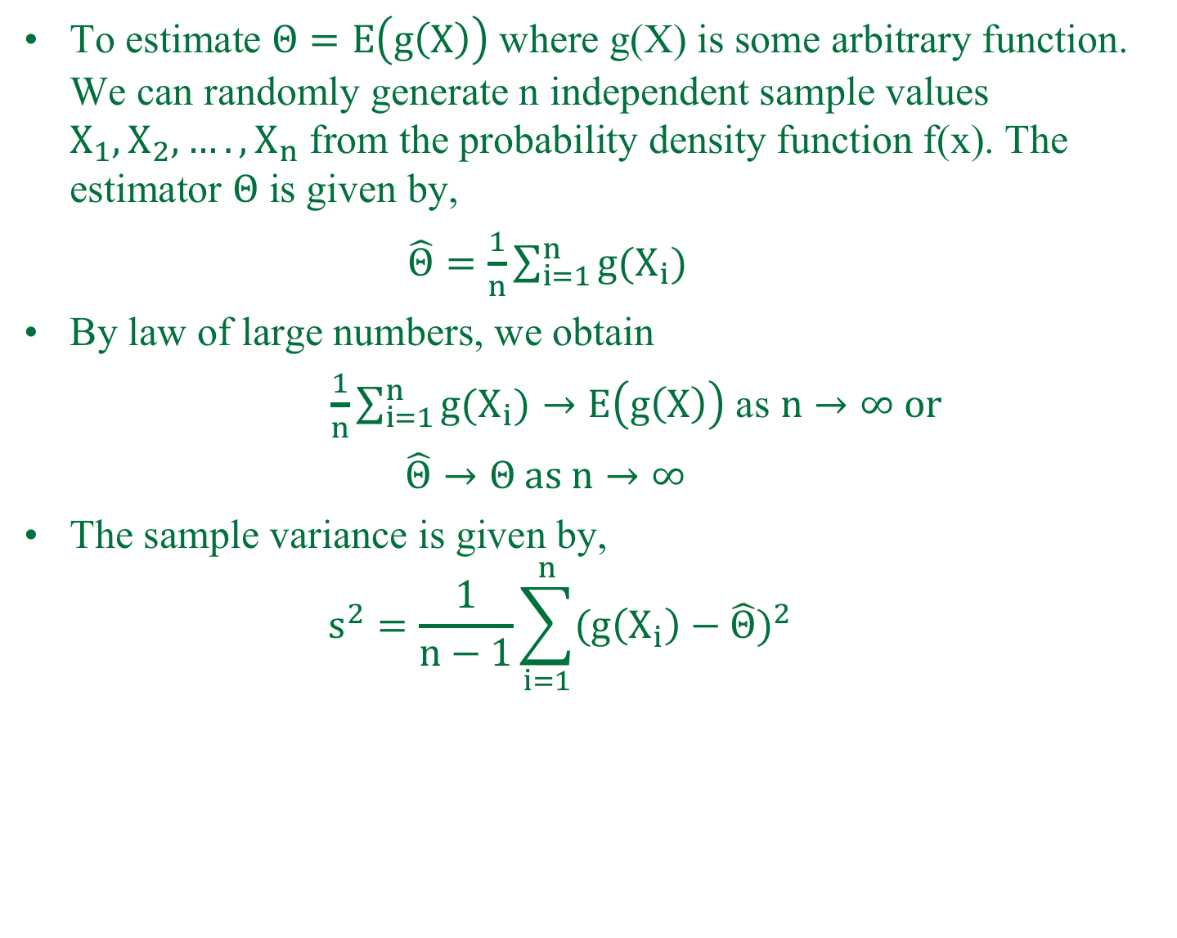
Monte Carlo simulation(contd..)
To estimate $Θ=E\left(g\left(X\right)\right)$ where g(X) is some arbitrary function. We can randomly generate n independent sample values $X_{1},X_{2},….,X_{n}$ from the probability density function f(x). The estimator $Θ$ is given by,
$\hat{Θ}=\frac{1}{n}\sum_{i=1}^{n}{g(X_{i})}$
By law of large numbers, we obtain
$\frac{1}{n}\sum_{i=1}^{n}{g(X_{i})}→E\left(g\left(X\right)\right)$ as $n→∞ or$
$\hat{Θ}→Θ as n→∞$
The sample variance is given by,
$$s^{2}=\frac{1}{n−1}\sum_{i=1}^{n}{({g\left(X_{i}\right)−\hat{Θ})}^{2}}$$

Slide 11
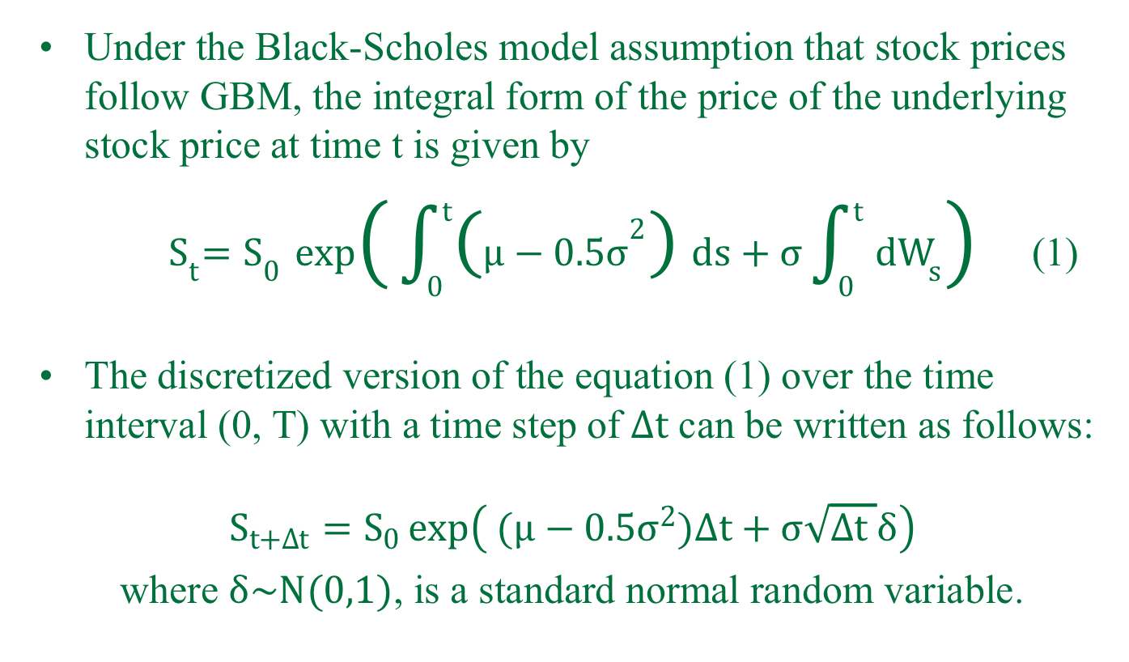
Monte Carlo simulation(contd..)
Under the Black-Scholes model assumption that stock prices follow GBM, the integral form of the price of the underlying stock price at time t is given by
${ S}_{t}=S_{0}\exp\left( \int_{0}^{t}{\left(μ−0.5σ^{2}\right)}ds+σ\int_{0}^{t}{dW_{s}}\right)$ (1)
The discretized version of the equation (1) over the time interval (0, T) with a time step of $∆t$ can be written as follows:
$$S_{t+∆t}=S_{0}\exp\left( (μ−0.5σ^{2})∆t+σ\sqrt{∆t }δ\right)$$
where $δ\sim N(0,1)$, is a standard normal random variable.

Slide 12
Monte Carlo simulations(contd..)
There are mainly two techniques to improve the efficiency of Monte Carlo simulations.
1) Number of simulations (computational burden)
2) Variance reduction methods
a) Antithetic variates
b) Control variates
c) Conditional Monte Carlo
d) Importance Sampling

Slide 13
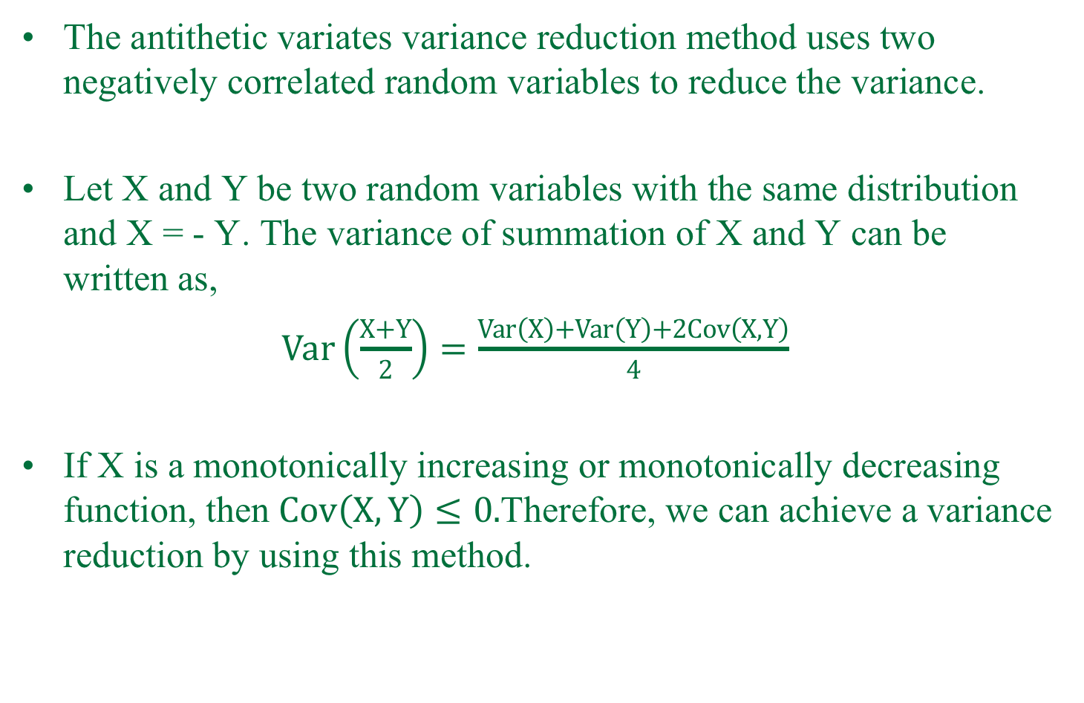
Antithetic variates
The antithetic variates variance reduction method uses two negatively correlated random variables to reduce the variance.
Let X and Y be two random variables with the same distribution and X = - Y. The variance of summation of X and Y can be written as,
$Var\left(\frac{X+Y}{2}\right)=\frac{Var\left(X\right)+Var\left(Y\right)+2Cov\left(X,Y\right)}{4}$
If X is a monotonically increasing or monotonically decreasing function, then $Cov\left(X,Y\right)≤0.$Therefore, we can achieve a variance reduction by using this method.

Slide 14
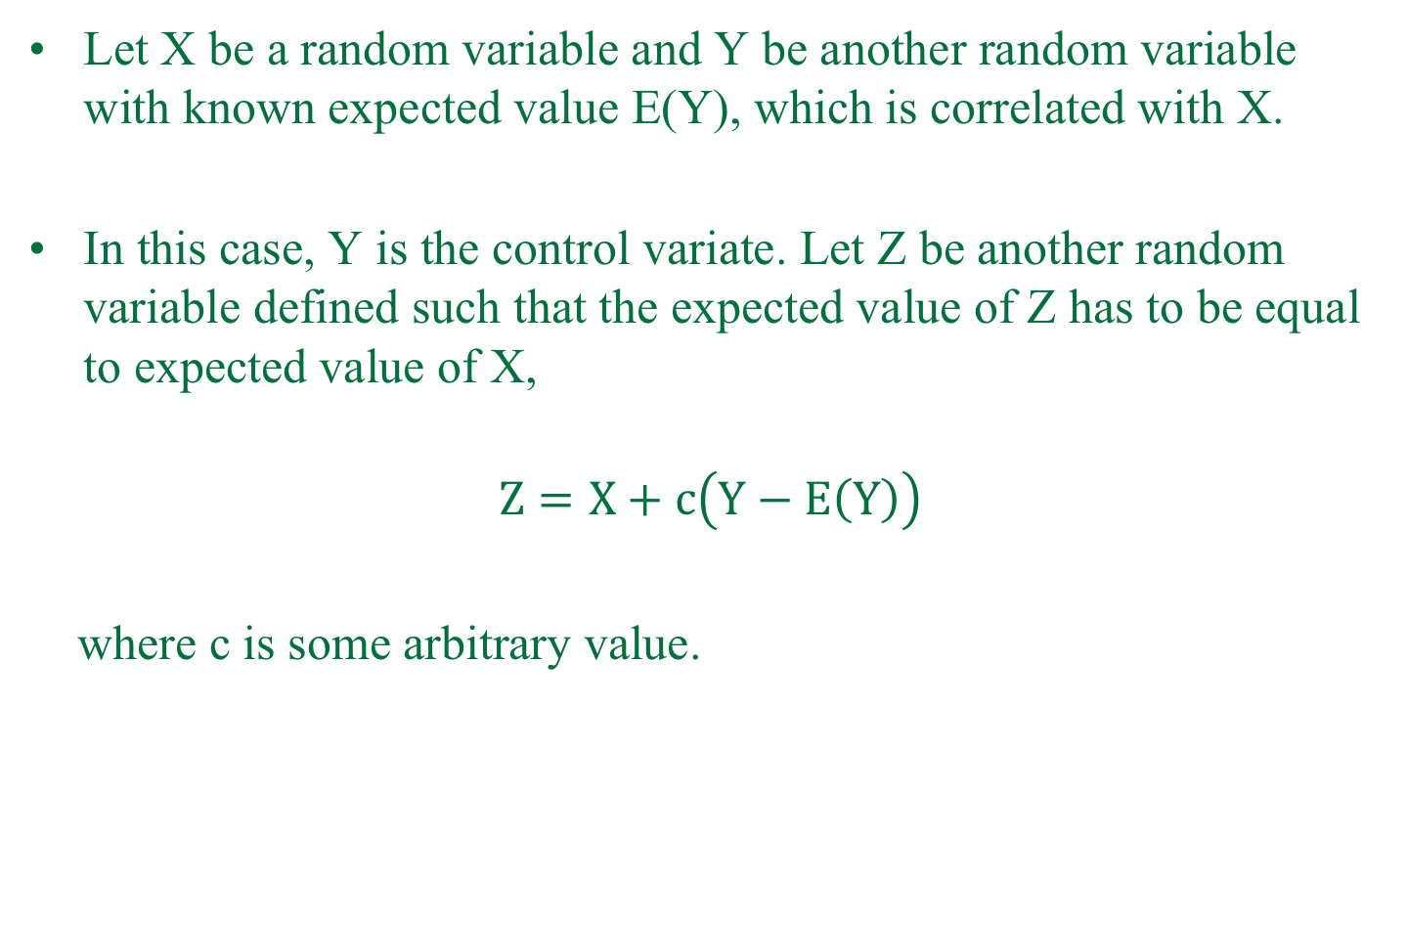
Control variates
Let X be a random variable and Y be another random variable with known expected value E(Y), which is correlated with X.
In this case, Y is the control variate. Let Z be another random variable defined such that the expected value of Z has to be equal to expected value of X,
$$Z=X+c\left(Y−E\left(Y\right)\right)$$
where c is some arbitrary value.

Slide 15
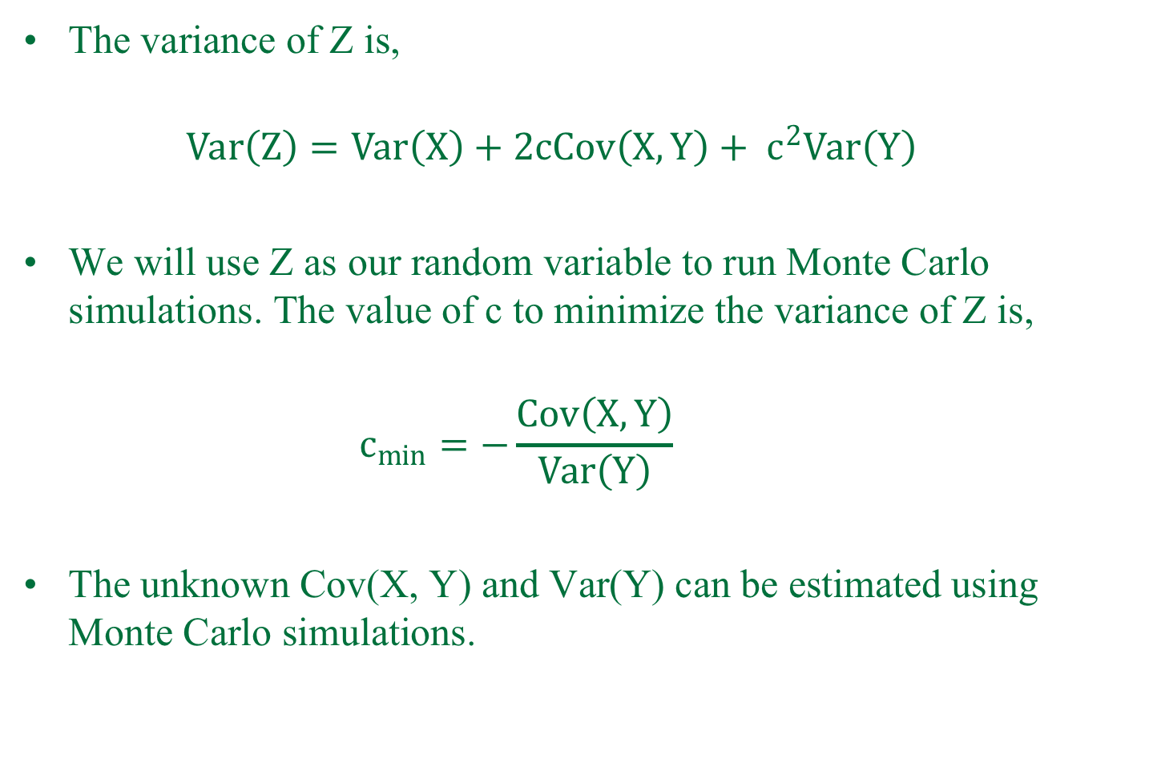
Control variates(contd..)
The variance of Z is,
$$Var\left(Z\right)=Var\left(X\right)+2cCov\left(X,Y\right)+ c^{2}Var\left(Y\right)$$
We will use Z as our random variable to run Monte Carlo simulations. The value of c to minimize the variance of Z is,
$$c_{min}=−\frac{Cov\left(X,Y\right)}{Var\left(Y\right)}$$
The unknown Cov(X, Y) and Var(Y) can be estimated using Monte Carlo simulations.

Slide 16
Conditional Monte Carlo
The conditional Monte Carlo variance reduction method is based on the parity relation given by,
c = c_{up-and-in} + c_{up-and-out}
The Monte Carlo simulation is stopped as soon as the price of the underlying stock hits the barrier level.
The barrier option behaves as a plain vanilla option once the barrier level is reached.

Slide 17
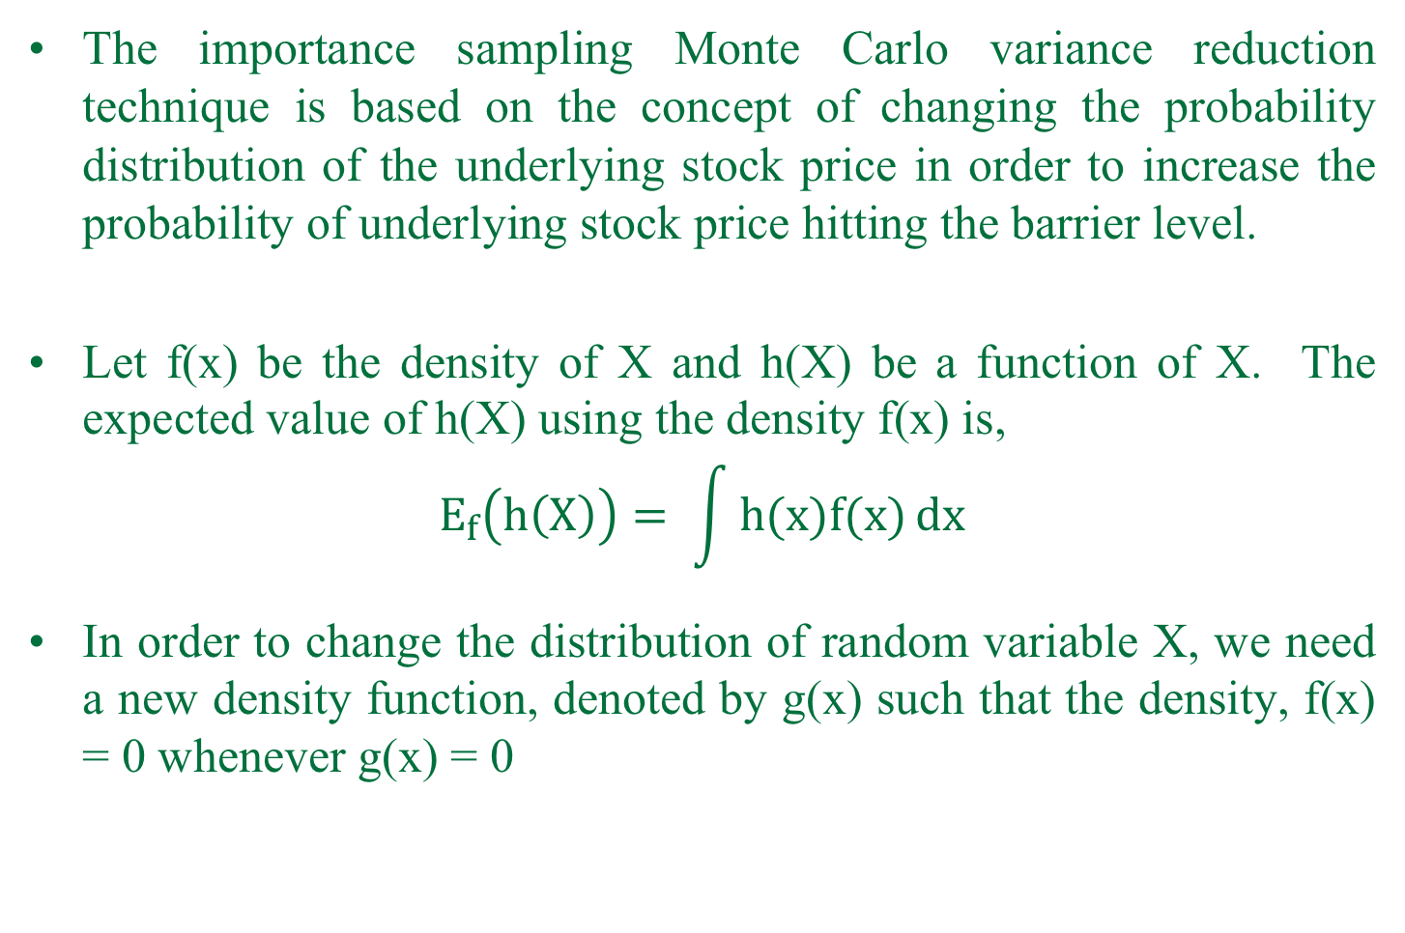
Importance Sampling
The importance sampling Monte Carlo variance reduction technique is based on the concept of changing the probability distribution of the underlying stock price in order to increase the probability of underlying stock price hitting the barrier level.
Let f(x) be the density of X and h(X) be a function of X. The expected value of h(X) using the density f(x) is,
$$E_{f}\left(h\left(X\right)\right)= \int{h(x)f(x)}dx$$
In order to change the distribution of random variable X, we need a new density function, denoted by g(x) such that the density, f(x) = 0 whenever g(x) = 0

Slide 18
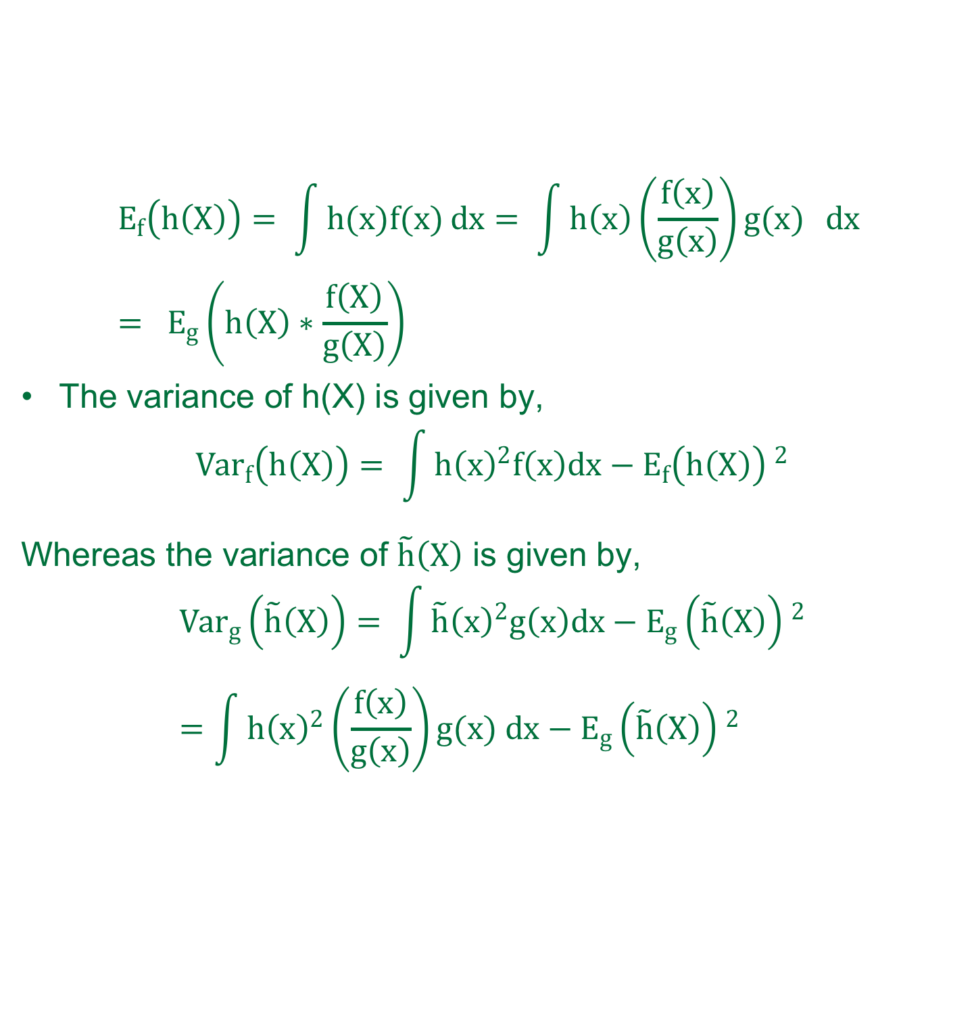
Importance Sampling
$$E_{f}\left(h\left(X\right)\right)= \int{h(x)f(x)}dx= \int{h\left(x\right)\left(\frac{f\left(x\right)}{g\left(x\right)}\right)g(x) }dx = E_{g}\left(h\left(X\right)∗\frac{f\left(X\right)}{g\left(X\right)}\right)$$
The variance of h(X) is given by,
$${Var}_{f}\left(h\left(X\right)\right)= \int{{h\left(x\right)}^{2}f\left(x\right)dx}−{E_{f}\left(h\left(X\right)\right) }^{2}$$
Whereas the variance of $\tilde{h}\left(X\right)$ is given by,
$${Var}_{g}\left(\tilde{h}\left(X\right)\right)= \int{{\tilde{h}\left(x\right)}^{2}g\left(x\right)dx}−{E_{g}\left(\tilde{h}\left(X\right)\right) }^{2}=\int{{h\left(x\right)}^{2}\left(\frac{f\left(x\right)}{g\left(x\right)}\right)g(x) dx}−{E_{g}\left(\tilde{h}\left(X\right)\right) }^{2}$$

Slide 19
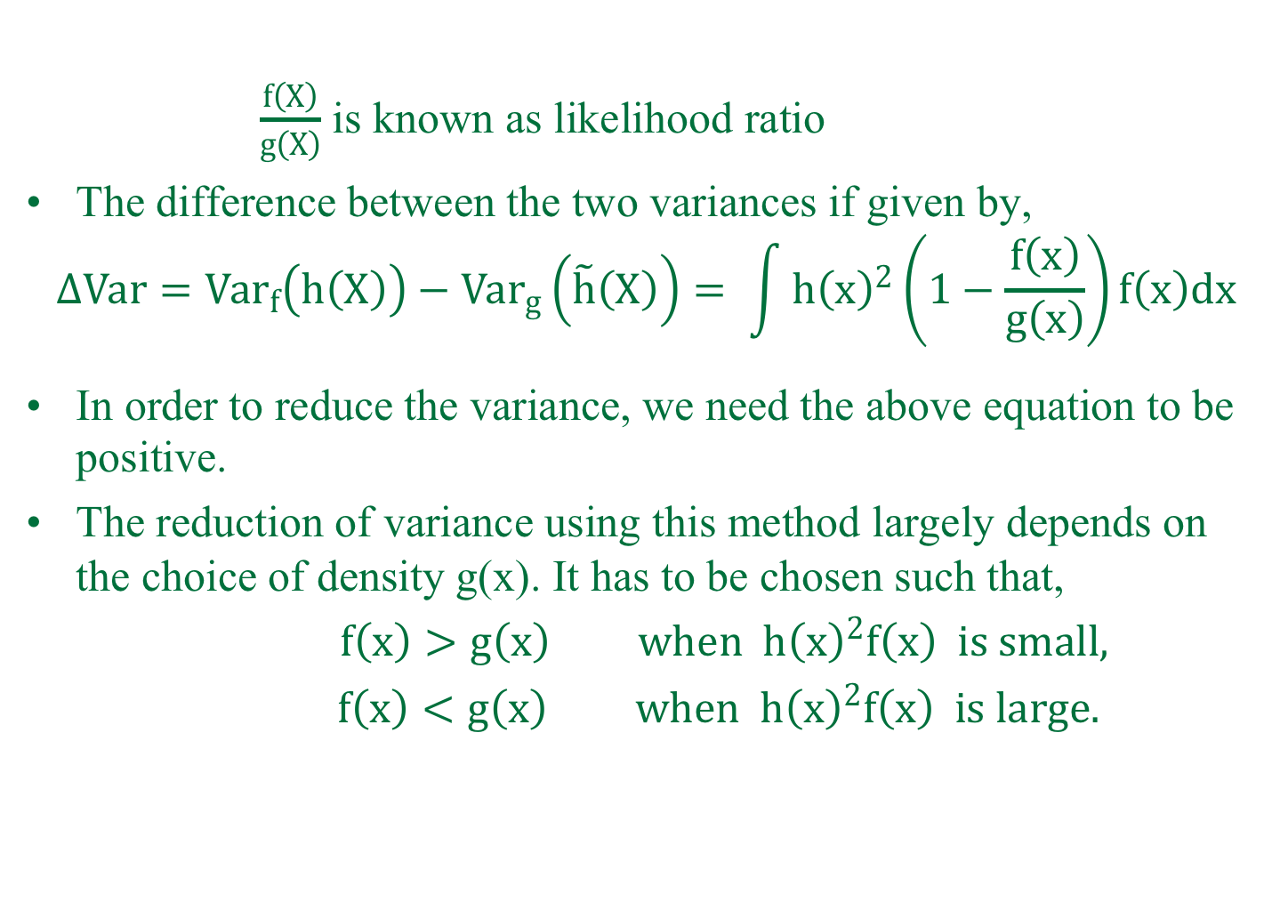
Importance Sampling(contd..)
$\frac{f\left(X\right)}{g\left(X\right)}$ is known as likelihood ratio
The difference between the two variances if given by,
$${∆Var=Var}_{f}\left(h\left(X\right)\right)−{Var}_{g}\left(\tilde{h}\left(X\right)\right)= \int{{h\left(x\right)}^{2}\left(1−\frac{f\left(x\right)}{g\left(x\right)}\right)f\left(x\right)dx}$$
In order to reduce the variance, we need the above equation to be positive.
The reduction of variance using this method largely depends on the choice of density g(x). It has to be chosen such that,
$f\left(x\right)>g\left(x\right) when {h\left(x\right)}^{2}f\left(x\right) is small,$
$f\left(x\right)<g\left(x\right) when {h\left(x\right)}^{2}f\left(x\right) is large.$

Slide 20
Introduction
Methodology
Results
Recommendations

Slide 21
Results
The variables values used for the simulations are:
K = 45
T = 1
r= 1%
sigma = 20%

Slide 22
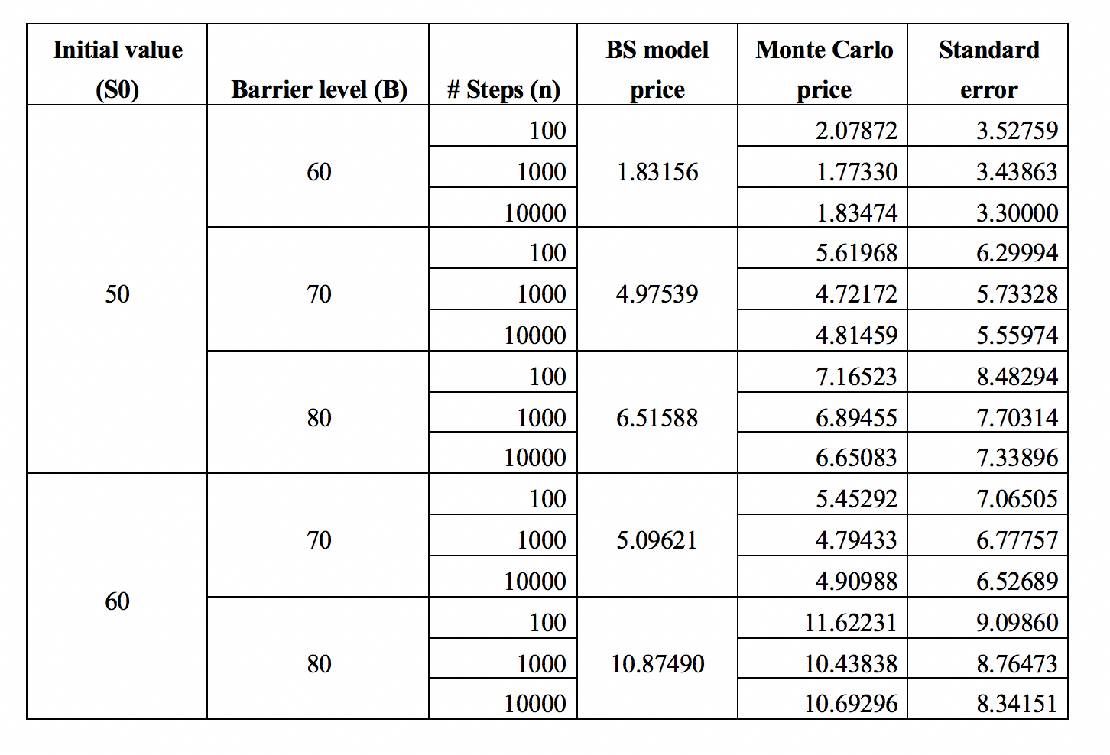
Simple Monte Carlo

Slide 23
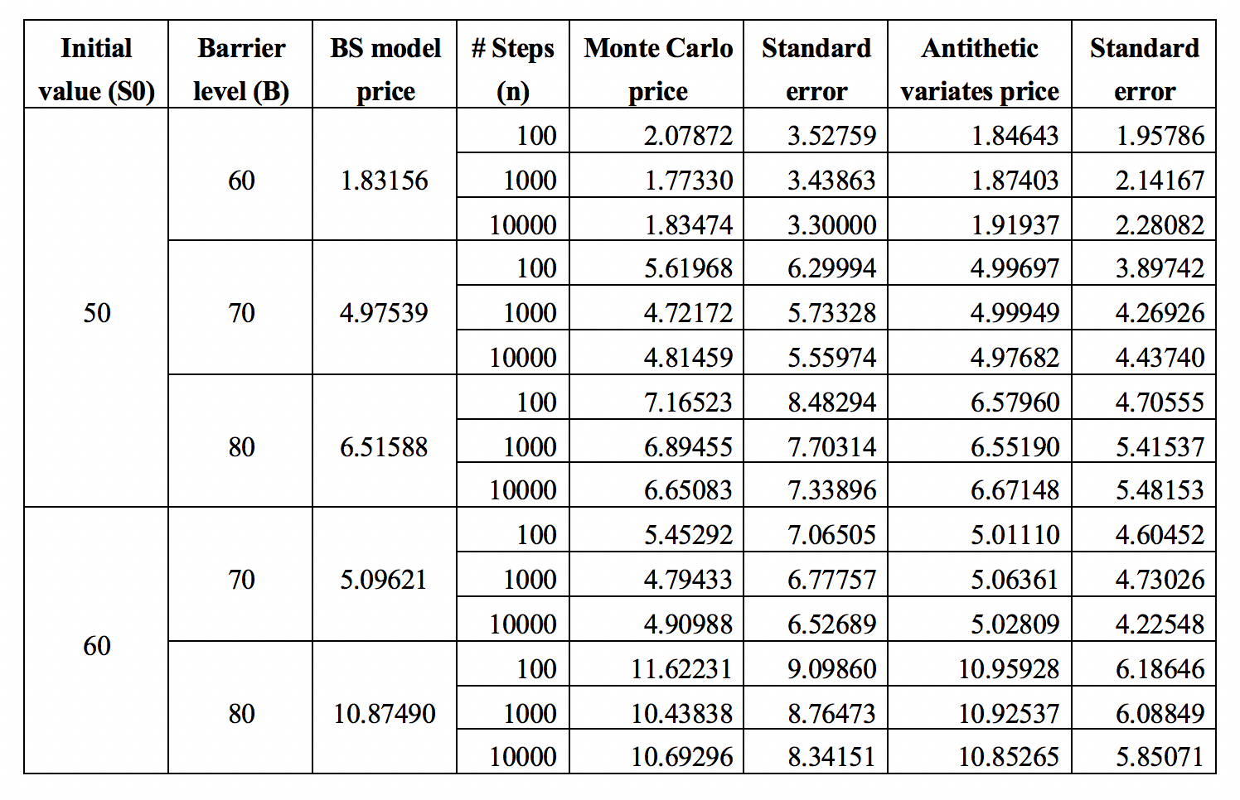
Antithetic Variates

Slide 24
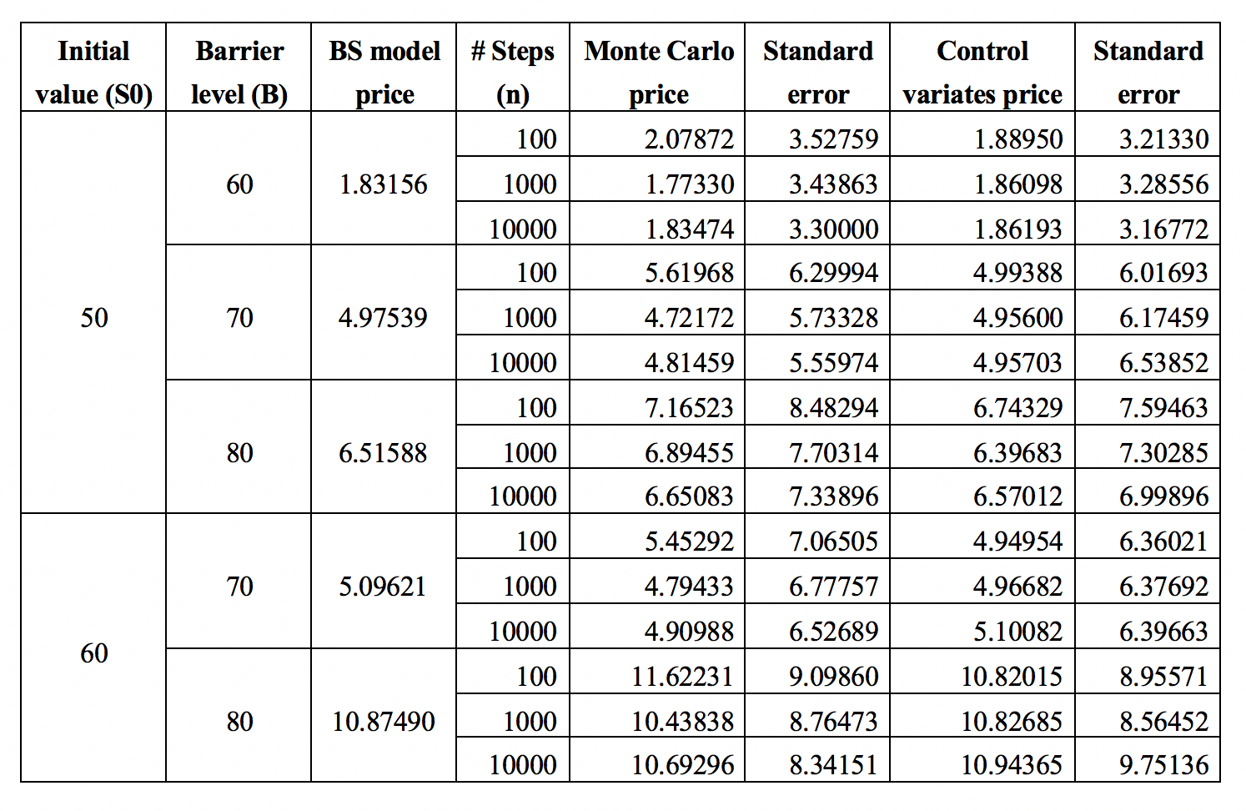
Control Variates

Slide 25
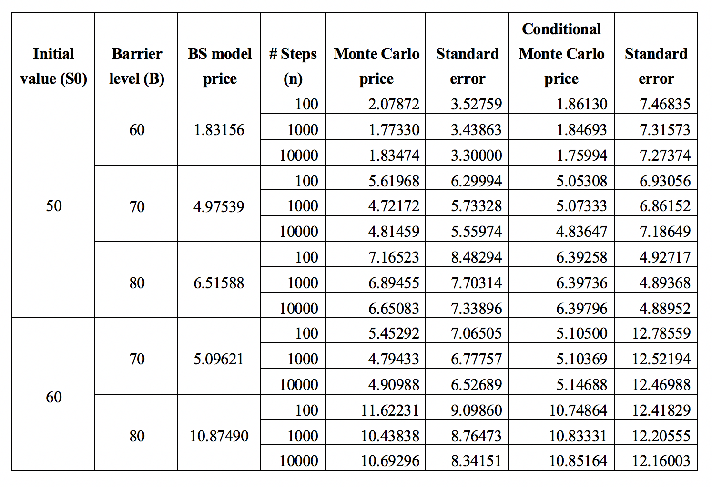
Conditional Monte Carlo

Slide 26
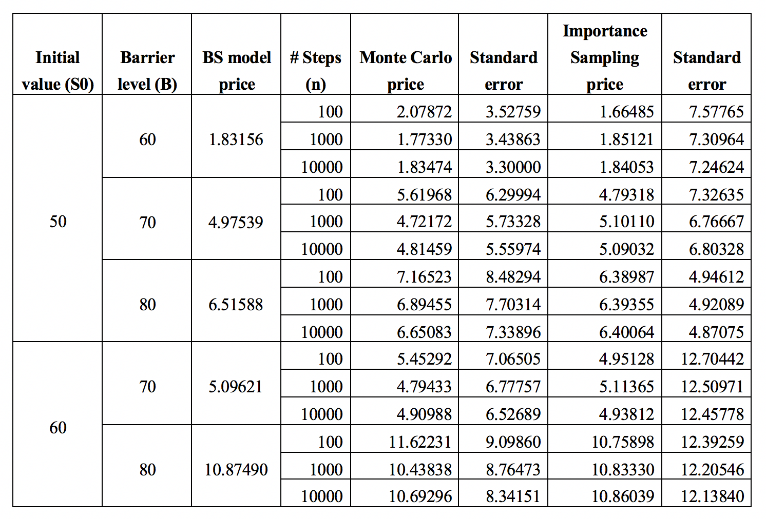
Combined Conditional MC & Importance Sampling

Slide 27
Introduction
Methodology
Results
Recommendations

Slide 28
Recommendations
Antithetic variates & Control variates works better compared to simple Monte Carlo simulations with lower number of simulations.
Conditional Monte Carlo and Importance Sampling should be used when the gap between barrier level, B and exercise price K is large.

